Slide 1
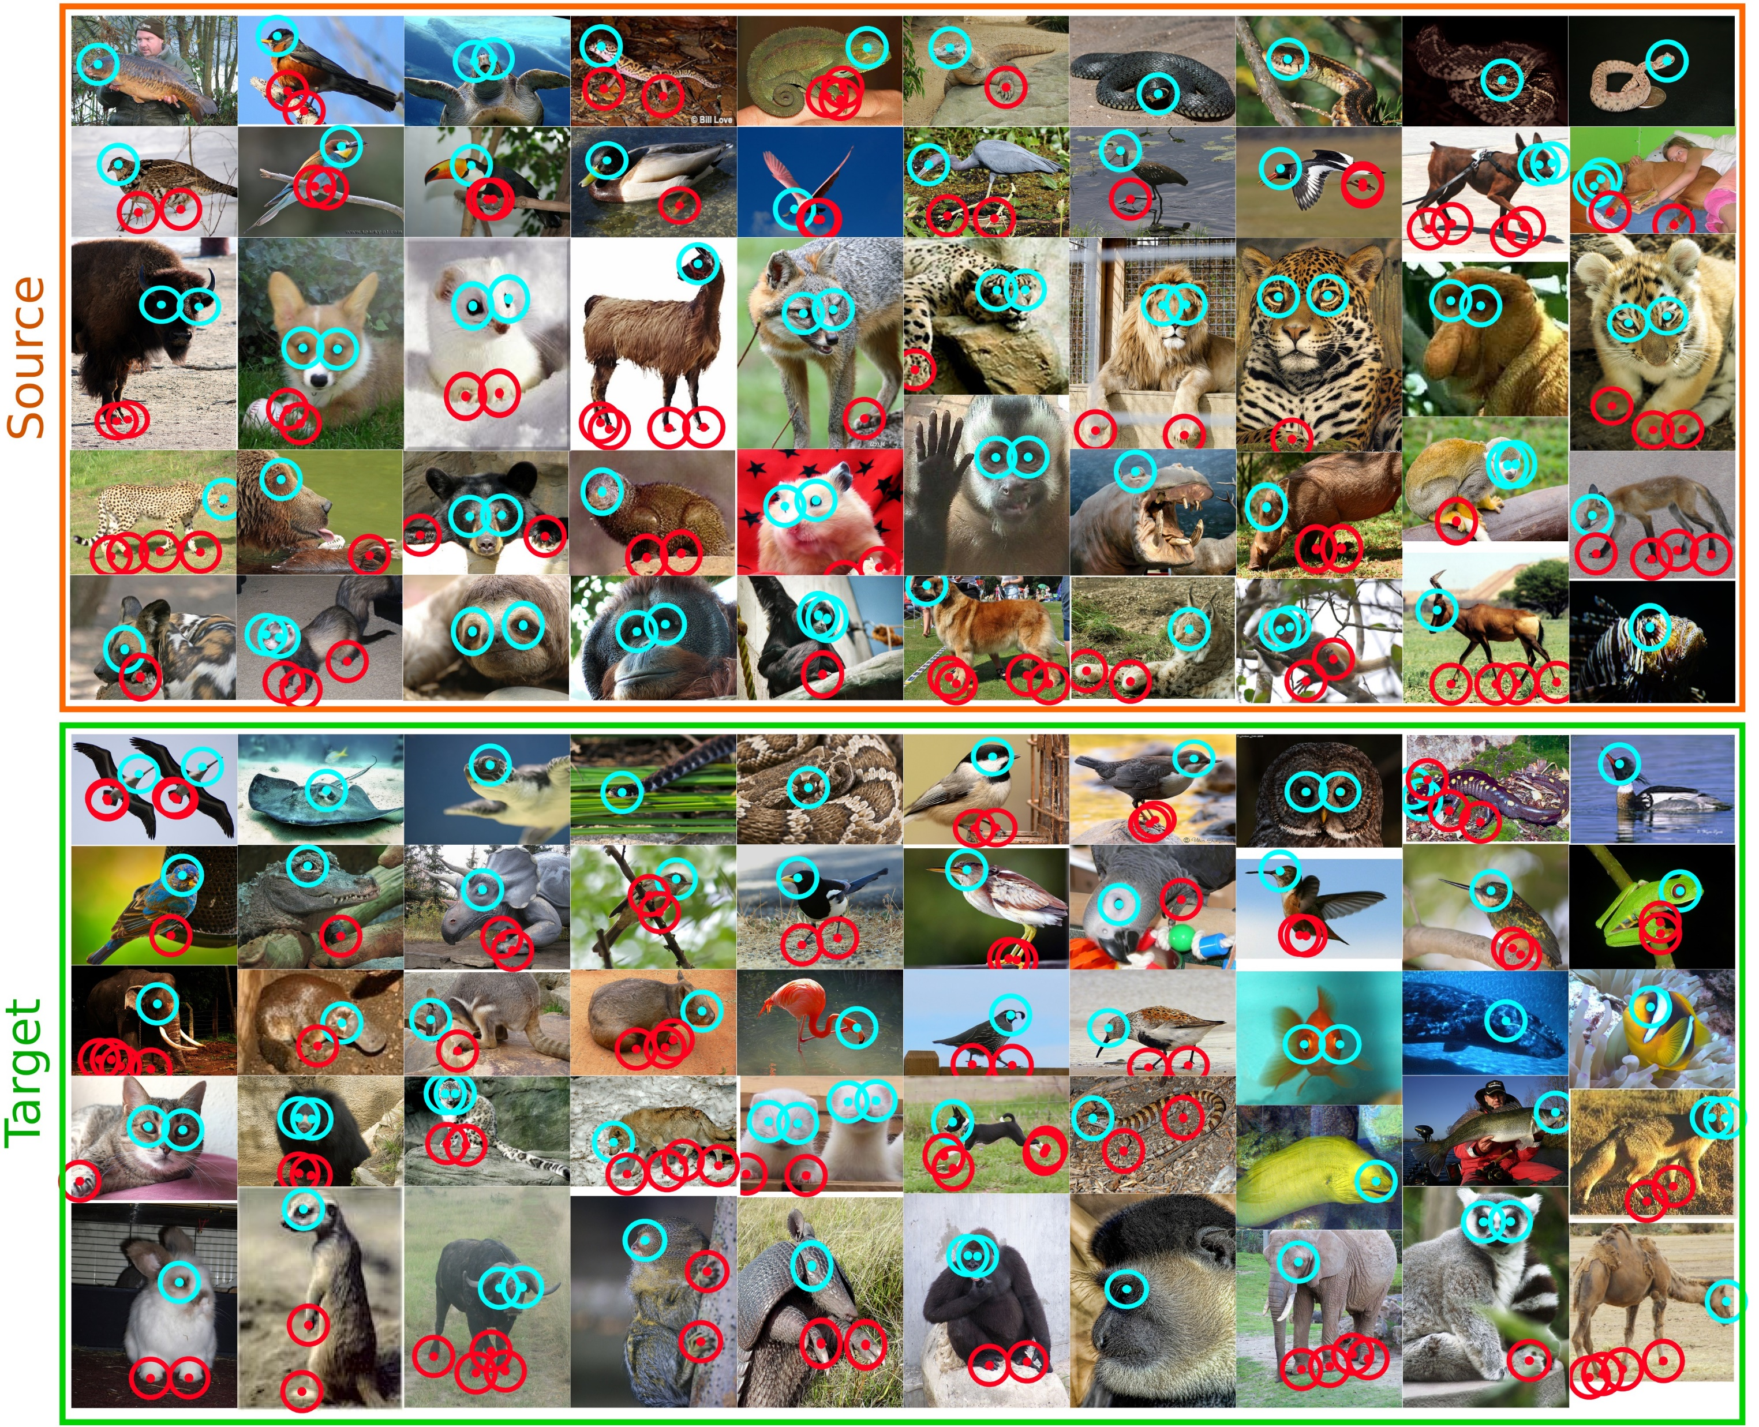
Dataset name | Size (pairs) | Class | Source datasets | Annotations | Characteristics
Animal-parts | ≈7,000 | 100 | ILSVRC 2012 | keypoints (1~6) | keypoints limited to eyes and feet of animals
Semantic Correspondence

Slide 2
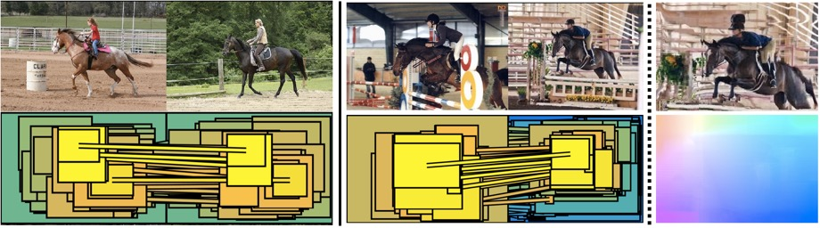
Dataset name | Size (pairs) | Class | Source datasets | Annotations | Characteristics
PF-WILLOW | 900 | 5 | PASCAL VOC 2007, Caltech-256 | keypoints (10) | center-aligned images, pairs with the same viewpoint
PF-PASCAL | 1,300 | 20 | PASCAL VOC 2007 | keypoints (4~17) | pairs with the same viewpoint

Slide 3
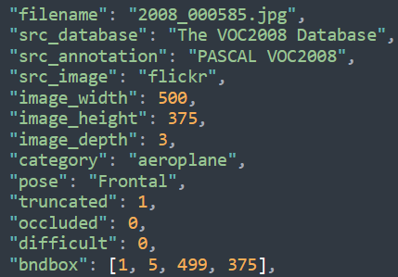
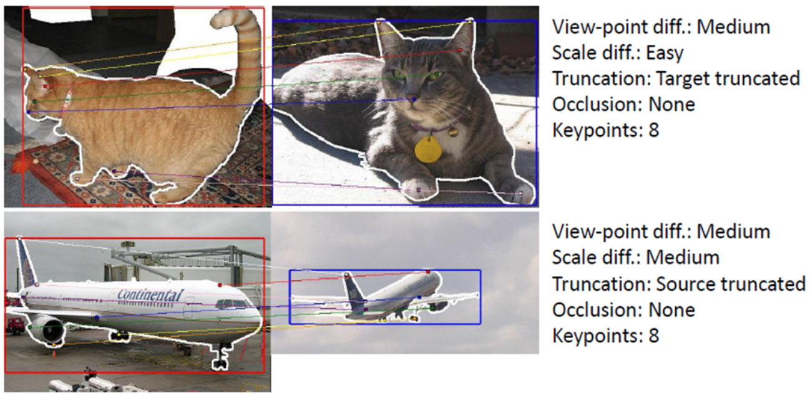
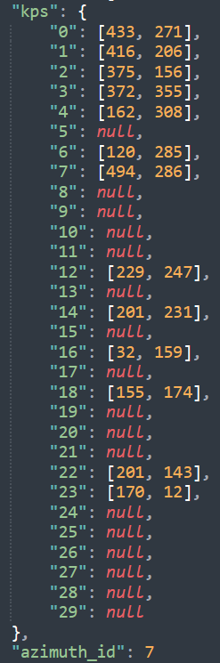
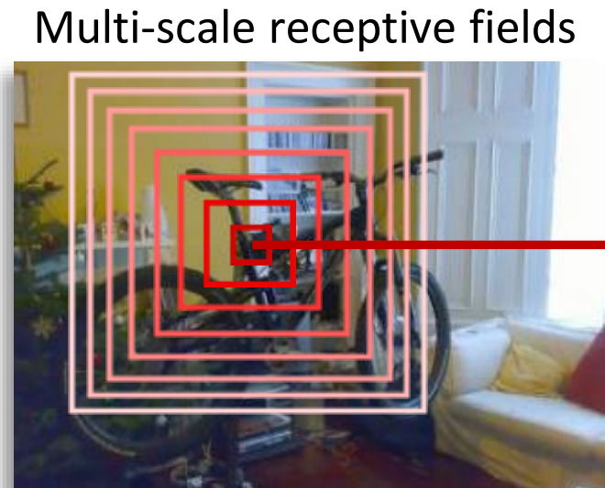
Dataset name | Size (pairs) | Class | Source datasets | Annotations | Characteristics
SPair-71k | 70,958 | 18 | PASCAL3D+, PASCAL VOC 2012 | keypoints (3~30) | large-scale data with diverse variations, rich annotations

Slide 4
